Slide 1

Cyberbullying In Twitter
By: Karan Ajay Pisay and Srashti Soni
Under the Guidance of Prof. Ozgur Ozturk
Data 606: Capstone In Data Science

Slide 2


Our Team
Karan Ajay Pisay Srashti Soni

Slide 3
Table of Contents
01
02
03
Introduction
Literature Survery
Dataset
04
05
Exploratory Data Analysis
Model Training and Evaluation

Slide 4
Introduction:
Cyberbullying has become a major concern in today's digital world, with the rise of social media platforms and online communication.
Identify and flag potentially harmful tweets that may constitute cyberbullying. By using machine learning algorithms, our system is trained to analyze tweet content and identify patterns and keywords associated with cyberbullying. Once identified, the tweet can be flagged for review by moderators or administrators, who can take appropriate action.
We believe that our application can make a real difference in the fight against cyberbullying.

Slide 5
Literature Survey:
"A Machine Learning Approach to Detect Cyberbullying on Twitter" by Vahid Tayyebi and Hassan Takabi (2017): This paper presents a machine learning approach to detect cyberbullying on Twitter by analyzing tweet content and user interactions. The authors evaluate the performance of their approach using a dataset of 2,000 tweets, achieving an accuracy of 81%.
"Cyberbullying Detection on Instagram Using Deep Learning Techniques" by Mahnaz Habibi and Saba Saeed (2019): This paper proposes a deep learning-based approach for detecting cyberbullying on Instagram. The authors evaluate their approach using a dataset of 10,000 posts, achieving an accuracy of 89%.
"Machine Learning for the Detection of Cyberbullying on Twitter" by Dora Livadariu and Catalin Stoean (2018): This paper presents a machine learning-based approach for detecting cyberbullying on Twitter by analyzing the sentiment and context of tweets. The authors evaluate the performance of their approach using a dataset of 3,000 tweets, achieving an accuracy of 77%.

Slide 6
Our Hypothesis:
The primary objective of this project is to develop a highly efficient and accurate model that leverages advanced natural language processing techniques to automatically identify and flag potentially harmful tweets. The model will be designed to not only recognize instances of cyberbullying but also break down the patterns of hatred exhibited in the tweets.
Through a thorough analysis of the words and language used in each tweet, our model will be capable of predicting whether a tweet is a cyberbullying tweet or not with a high degree of precision. Additionally, for tweets that are identified as cyberbullying, our model will further categorize the nature of the cyberbullying into six different categories: age, ethnicity, gender, religion, and other cyberbullying.
By achieving this objective, we hope to make a significant contribution to the fight against online harassment and create a safer, more inclusive social media environment for everyone.

Slide 7
About Dataset:
The dataset contains more than 47000 tweets labelled according to the class of cyberbullying:
Age;
Ethnicity;
Gender;
Religion;
Other type of cyberbullying;
Not cyberbullying
Source of the Dataset: https://lnkd.in/d7pfHGT8

Slide 8
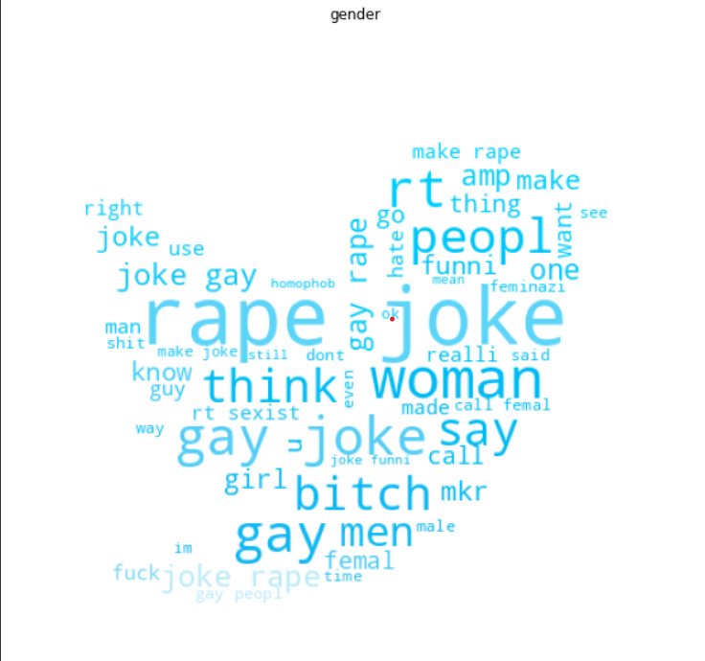
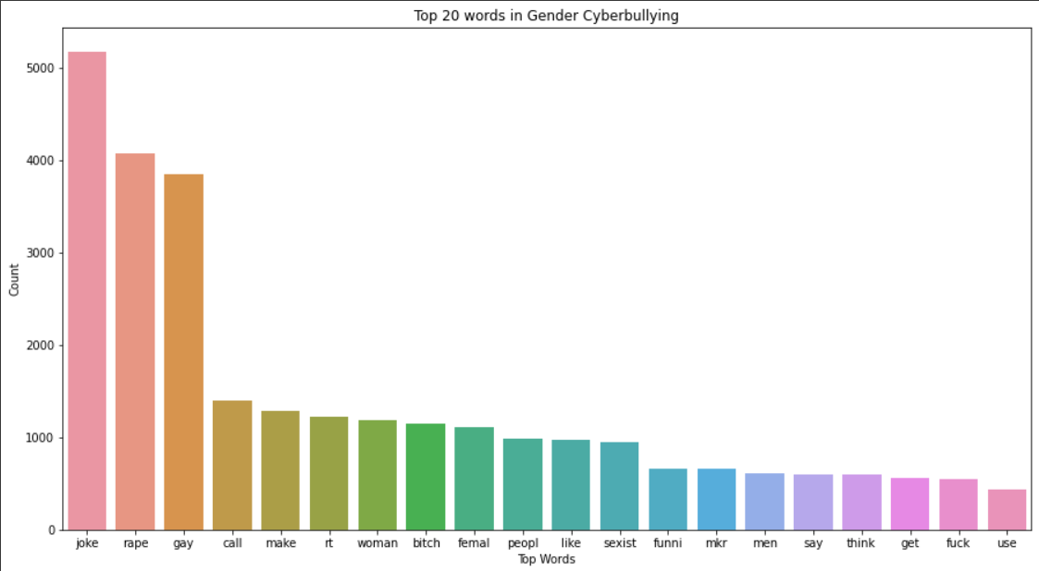
Exploratory Data Analysis:
Gender Based Cyberbullying:

Slide 9
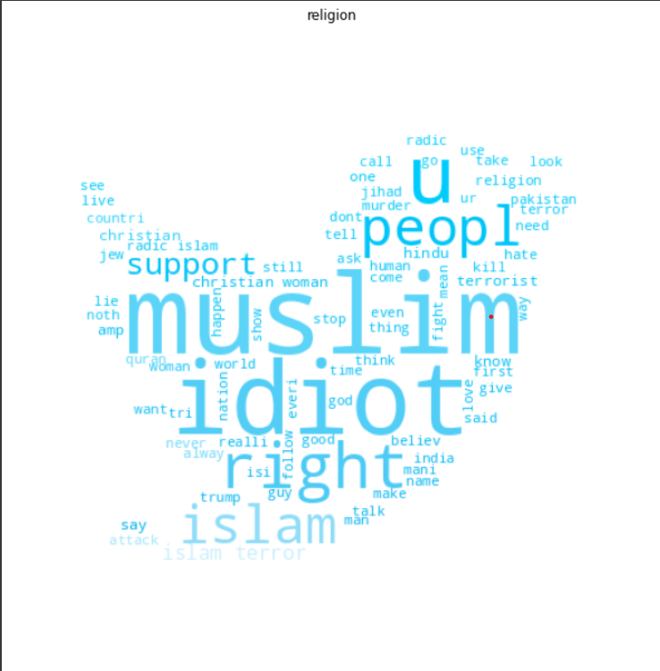
Based On Religion:

Slide 10
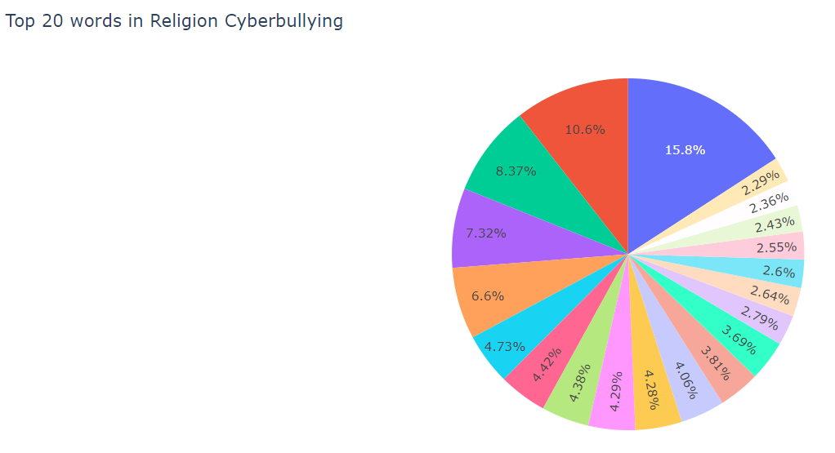
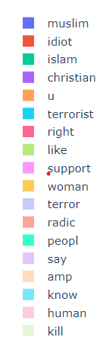

Slide 11
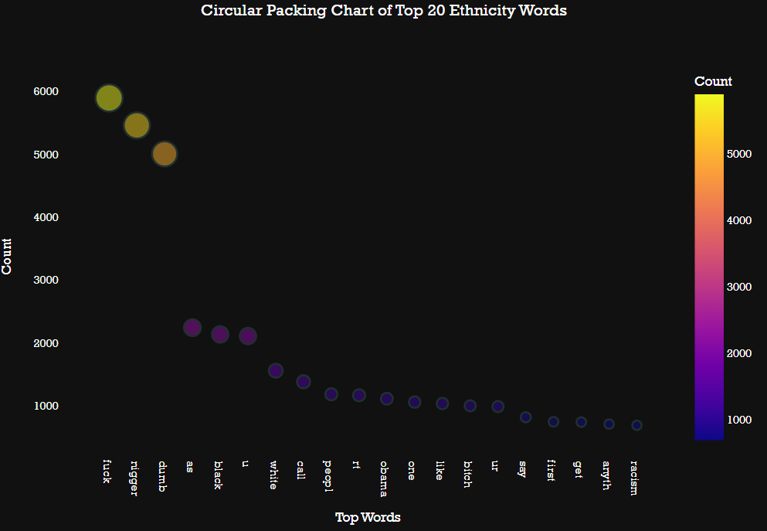
Ethinicity Based Bullying:

Slide 12
Model Training and Evaluation:
Data was split between the training set and the testing set in the ratio of 70:30.
List of different models trained to obtain the optimal accuracy:
Model Name | Accuracy
Logistic Regression Model | 82.44%
Support Vector Machine | 82.90%
Naive Bayes Classifier | 67.50%
Decision Tree Classifier | 80.89%
Random Forest Classifier | 82.25%
AdaBoost Classifier | 75.01%

Slide 13

WHY SVM?
By trying different models, we can see logistic regression, SVM and random forest classifier performed similarly, so among these we will go with SVM model as it is more generalized and lighter.
SVMs are designed to maximize the margin between classes, which means they aim to find the decision boundary that is farthest away from the training examples. This can lead to better generalization, as the model is less likely to overfit the training data.
SVMs use a regularization parameter, which helps to prevent overfitting by penalizing large coefficients. This can make the model lighter, as it reduces the number of features that are included in the final model.
Notes:
There are several reasons why the SVM (Support Vector Machine) model can be more generalized and lighter than other machine learning models such as random forest and logistic regression:
SVMs are designed to maximize the margin between classes, which means they aim to find the decision boundary that is farthest away from the training examples. This can lead to better generalization, as the model is less likely to overfit the training data.
SVMs use a regularization parameter, which helps to prevent overfitting by penalizing large coefficients. This can make the model lighter, as it reduces the number of features that are included in the final model.
SVMs are often used with kernel functions, which can transform the input features into a higher-dimensional space. This can make it easier to separate the classes, as the data may be more separable in the transformed space.
Random forests are ensemble models that can be prone to overfitting if the trees are too complex. This can result in a larger and less generalized model.
Logistic regression models can also be prone to overfitting if there are too many features or interactions between features. This can lead to a larger and less generalized model.
Overall, SVMs are designed to maximize the margin between classes and use regularization to prevent overfitting. This can result in a more generalized and lighter model compared to other machine learning models. However, the choice of model ultimately depends on the specific problem and the characteristics of the data.

Slide 14

Fine Tuning Of Support Vector Machine:
Fine-tuning of SVM (Support Vector Machine) refers to the process of optimizing the hyperparameters of the model to improve its performance on a given dataset. Reasons for Fine Tuning SVM: 1. Improved performance 2. Generalization 3. Adaptability 4. Efficiency
Notes:
Why fine tuning is important?
- The hyperparameters are the settings that are not learned by the algorithm during training, such as the kernel type, kernel coefficient, regularization parameter, and so on. Fine-tuning involves selecting the optimal values for these hyperparameters, which can have a significant impact on the performance of the model. Improved performance: Fine-tuning the hyperparameters can result in a more accurate and effective model, as the optimal settings can help the model better capture the underlying patterns in the data.
Generalization: Fine-tuning can help to improve the generalization of the model, as the optimal hyperparameters can help to prevent overfitting on the training data and improve the model's ability to generalize to new, unseen data.
Adaptability: Fine-tuning allows the model to be adapted to the specific characteristics of the dataset and the problem at hand. Different datasets may require different hyperparameter settings to achieve optimal performance, and fine-tuning allows for this customization.
Efficiency: Fine-tuning can help to optimize the computational efficiency of the model, by selecting the hyperparameters that lead to the fastest and most efficient training and prediction.
Overall, fine-tuning of SVM is an important step in the machine learning workflow, as it allows for the optimization of the hyperparameters and the improvement of the model's performance, generalization, adaptability, and efficiency.

Slide 15
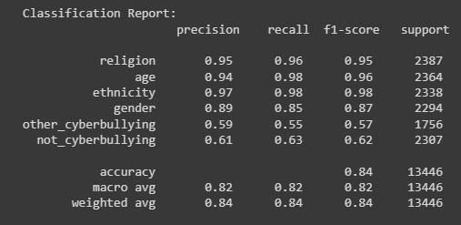
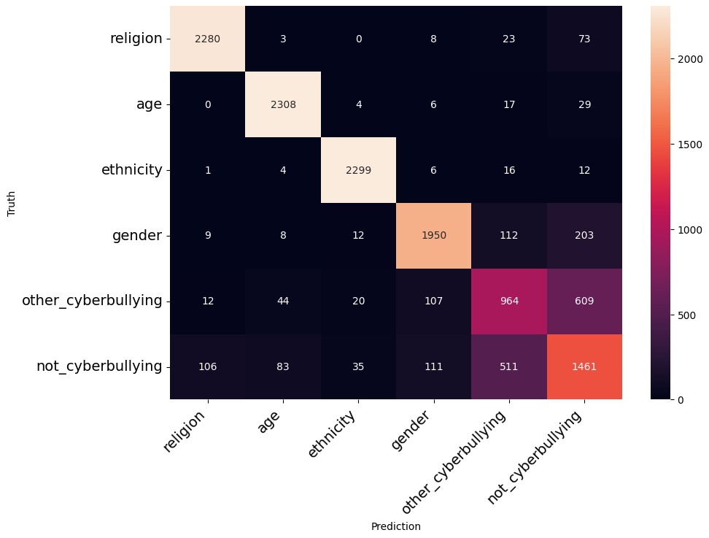
CLASSIFICATION REPORT:
CONFUSION MATRIX:

Slide 16

Thankyou!

